Slide 1
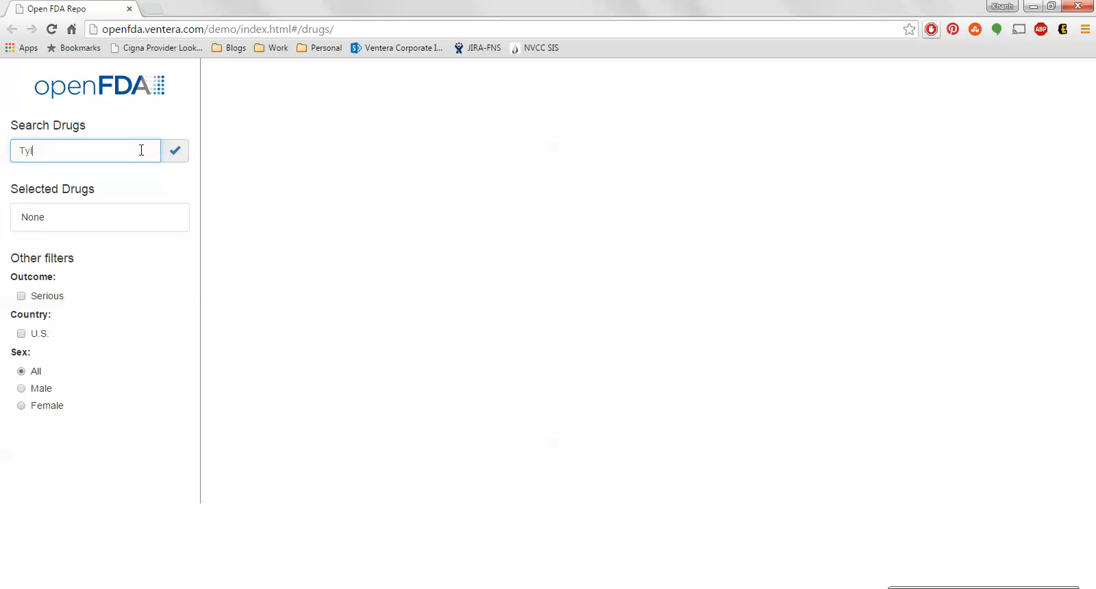
Exhibit 3.3: Working Prototype 1 Video Note: Hover over the image and click the Play button that appears at the bottom

Slide 2
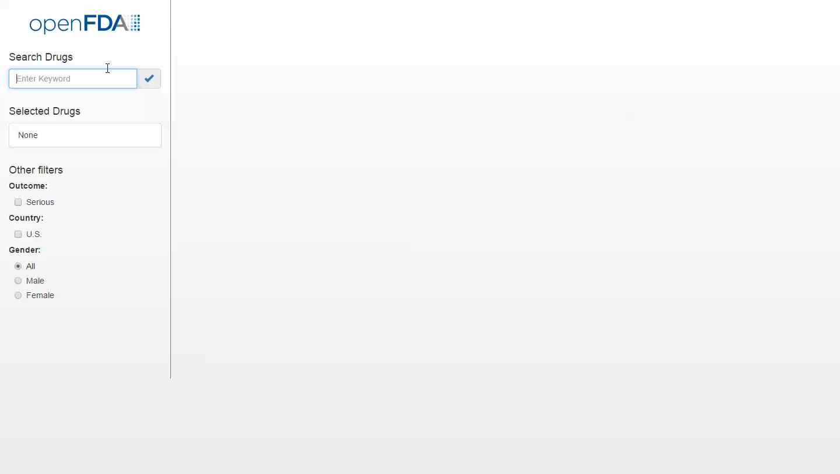
Exhibit 3.4: Working Prototype 2 (Post-Survey) Video
Note: Hover over the image and click the Play button that appears at the bottom

